Slide 1
SYSTEM ARCHITECTURE FOR A VIRTUAL PAYMENT APP(OFFERS VITUAL CARDS TOO)
Presented by Pearly K.

Slide 2
TABLE OF CONTENT
KEYNOTES
TASKS
Task 1
Task 2
Task 3
TASK 4

Slide 3
KEYNOTES
Virtual Payment App
Provides virtual cart via third service party
Uses redis

Slide 4
Tasks
TASK 1: Using a digital design software such as; figma or draw.io, draw a client sever architecture model for the request/response cycle.
TASK 2: How Redis Functions in Data Caching (and Architecture Diagram)?
TASK 3: Overall System Architecture
TASK 4: Programming language and DBMS justification

Slide 5
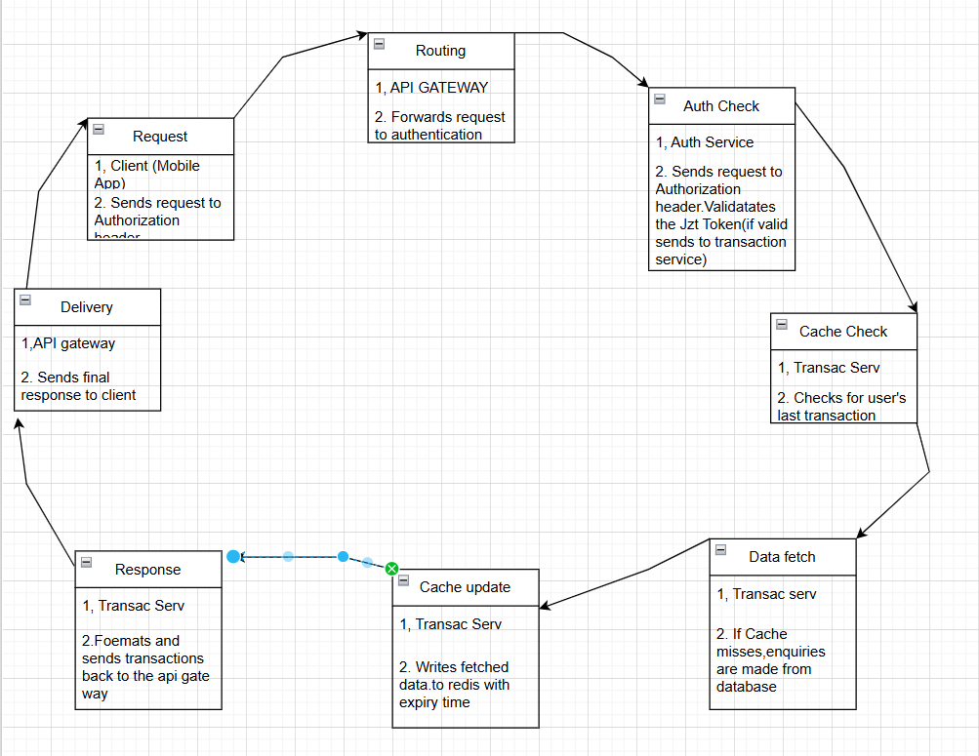
Task 1:client sever architecture model for the request/response cycle.
It Entails 8 steps; request, authorization check, cache check, data fetch, cache update, response, response, delivery.
The components are client 9 the app),auth serv, transaction service and api gateway.

Slide 6
TASK 2: How Redis Functions in Data Caching (and Architecture Diagram)?
Function in Data Caching:
Speed: As an in-memory store, it offers sub-millisecond latency for read/write operations, significantly faster than traditional disk-based databases.
Use Cases:
Transaction Caching: Storing the 10 most recent transactions for a user.
Session Management: Storing user session tokens for fast authentication validation.
Rate Limiting: Tracking the number of requests a user makes within a time window.
Data Structures: Its rich data structures (Strings, Hashes, Lists, Sets, Sorted Sets) allow for flexible caching strategies (e.g., using a Sorted Set to store transactions ordered by timestamp).
Eviction Policies: Redis can automatically remove keys based on rules (e.g., Least Recently Used - LRU) when memory limits are reached, ensuring it only holds the most relevant data.

Slide 7
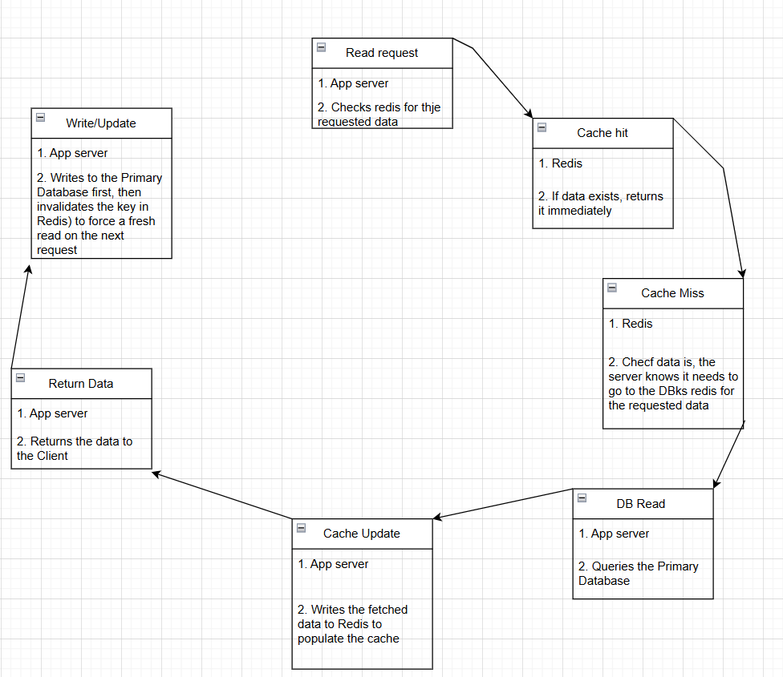
Architecture Diagram (Cache-Aside Pattern)

Slide 8
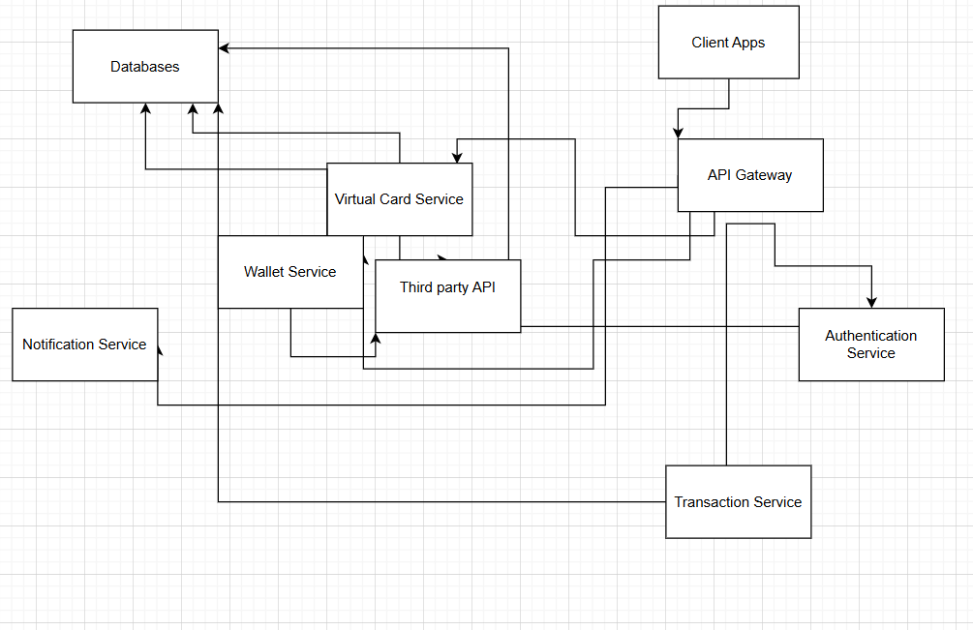
TASK 3: Overall System Architecture:
The over all system is made up of the following modules; Clent apps, API gateway, authentication serv, transact serv, virtal acrd serv, wallet serv, notification serv, and database.
Client interacts only with the API Gateway.
The API Gateway routes to the relevant Microservice.
Microservices use Redis for fast lookups (transactions, sessions) and the Primary Database for persistent storage.
The Virtual Card and Wallet Services communicate with External Third-Party APIs for their core functions.

Slide 9
TASK 4: Programming language and DBMS justification
GOLANG
JAVA
Concurrency: Go's native support for concurrency with goroutines and channels is highly efficient for handling a high volume of simultaneous requests.
Performance: As a compiled language, it offers excellent performance, crucial for low-latency transaction processing.
Simplicity: Go's simple syntax and tooling lead to faster development cycles and easier maintenance.
Mature Ecosystem: Java has a long-standing reputation in the enterprise and financial sectors with robust libraries and frameworks like Spring Boot.
Security: The Java Virtual Machine (JVM) provides a secure environment, and the ecosystem is well-equipped with security APIs.
Scalability: Java scales both vertically and horizontally, suitable for high-transaction volumes.

Slide 10
Database Management System (PostgreSQL)
For the primary system of record, a relational database is the most suitable choice because financial data requires strong consistency and transactional integrity (ACID compliance(atomicity, consistency, isolation, and durability)).
PostgreSQL:
ACID Compliance: Ensures that transactions are processed reliably, critical for financial data where data integrity is non-negotiable.
Reliability and Security: It is known for its robustness, data integrity, and strong security features, with a long and trusted history in the industry.
Extensibility: PostgreSQL is highly extensible and supports various data types, including native JSON support for flexibility.
Scalability: Supports both vertical and horizontal scaling with techniques like sharding to handle growing data loads.
Open-source: As an open-source solution, it avoids vendor lock-in and has a strong community

